Slide 1

Building a Market for Energy Efficiency in South Carolina: Potential Studies, Program Design and Implementation
SAFER, SMARTER, AND GREENER

Slide 2
Agenda
Introduction: Who is DNV GL?
  Formerly known as KEMA Consulting
Energy Efficiency Potential Studies
  Goals of Energy Efficiency Potential Studies
  Model Input Data Development
Creating a Market for Energy Efficiency
  Regulatory Policy
  State and Local Government Policies and Programs
  Ratepayer-funded Energy Efficiency Programs
Opportunities and Barriers
  Potential Barriers, Opportunities, and Reliability
  Experience from other states
Discussion

Slide 3





Highly Skilled People Across the World
MARITIME
OIL & GAS
ENERGY
BUSINESS ASSURANCE
150
years of operation
300+
offices
100
countries
16,500
employees
Notes:
Driven by our Purpose of safeguarding life, property and the environment, DNV GL enables organisations to advance the safety and sustainability of their business.
We provide classification and technical assurance along with software and independent expert advisory services to the maritime, oil and gas, and energy industries. We also provide certification services to customers across a wide range of industries.

Slide 4


Sustainable Energy Use

Slide 5
Energy Efficiency Potential Studies: A Brief Introduction

Slide 6
Goals of Energy Efficiency Potential Studies
Assess the potential for electric energy (kWh) and demand (kW) savings from utility- and state government-sponsored demand side management (DSM) programs, usually over a 5-20 year time horizon. Potential assessments typically produce:
  Estimates of the magnitude of potential savings on an annual basis, usually across different “program design scenarios”;
  Estimates of the costs associated with achieving those savings;
  Calculation of the cost-effectiveness of the achievable potential based on the estimates above.
  Energy efficiency potential for natural gas consumption can be developed as well.

Slide 7
Scope of Studies
DNV GL utilizes its in-house DSM ASSYST™ model to examine DSM potential from new and existing residential and non-residential buildings across utility service territories
Utility potential studies typically cover a 10-20 year time period
An energy efficiency potential analysis only includes DSM measures that are presently commercially available and is based on current codes and standards.
Assess technical and economic energy efficiency potential from opt-out, exempt, and non-jurisdictional customers. Achievable potential results do not include savings from these customers.
  Rigorous achievable potential results typically estimate the future impacts of energy efficiency under at least two levels of incentive scenarios (fifty and seventy-five percent).

Slide 8
DSM Potential –Energy Efficiency (EE) Potential
Technical potential is defined as the complete penetration of all measures analyzed in applications where they were deemed technically feasible from an engineering perspective.
Economic potential refers to the technical potential of those energy conservation measures that are cost effective when compared to supply-side alternatives.
Achievable program potential refers to the amount of savings that would occur in response to specific program funding and measure incentive levels. Savings associated with program potential are savings that are projected beyond those that would occur naturally in the absence of any market intervention.
Naturally occurring potential refers to the amount of savings estimated to occur as a result of normal market forces; that is, in the absence of any utility or governmental intervention.
Technical
Economic
Achievable Program
Naturally Occurring

Slide 9
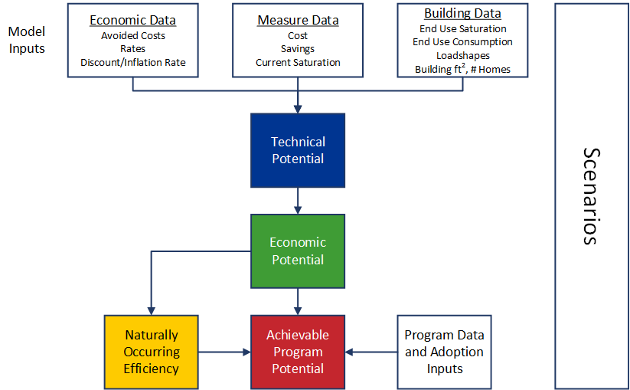
Overview of Modeling Process

Slide 10
Data Sources
Measure Data
EIA CBECS
Economic Data
Customer Discount Rate *
System Data
Billing data to identify consumption*
Program Budgets
South Carolina utility Program Tracking Data*
EIA RECS
ENERGY STAR Calculators
EIA Data for South Atlantic
TRMs
Inflation Rate *
Utility Discount Rate *
Avoided Cost and Retail Rate Forecasts*
System Load Data*
Data reported to EIA from South Carolina utilities to determine number of customers*
Line Loss Estimates*
Utility EM&V Results*
A * indicates a data source that contains utility-specific information

Slide 11
Savings Results from Past DNV GL Potential Studies

Slide 12
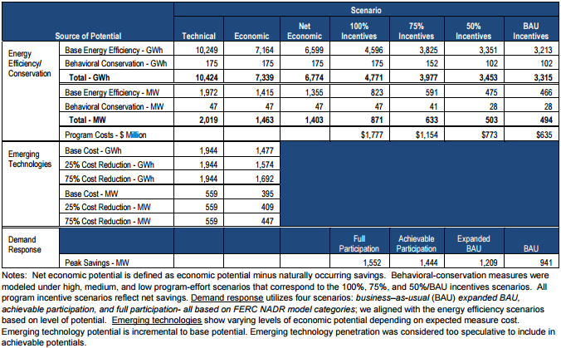
Xcel Energy Minnesota: Summary of Cumulative DSM Potentials from All Sources, 2011-2020

Slide 13
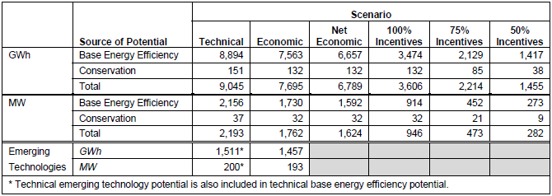
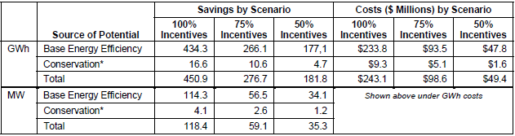
Xcel Energy Colorado, 2013-2020
Summary of Cumulative DSM Potentials
Average Annual Achievable Potentials and Program Costs

Slide 14
Dominion Virginia Power, 2013-2023:
Overview of Technical and Economic Potential Results
Sector | 2023 Base Energy Use (GWh) | Annual Potential in 2023 - GWh
 |  | Technical Potential | Economic Potential (High) | Economic Potential (Expected) | Economic Potential (Low)
Residential Total | 31,255 | 15,374 | 7,759 | 7,703 | 7,308
Savings % of Base |  | 49.2% | 24.8% | 24.6% | 23.4%
Non-Residential Total | 33,170 | 9,806 | 6,814 | 6,734 | 6,598
Savings % of Base |  | 29.6% | 20.5% | 20.3% | 19.9%
Opt-Out, Exempt, Non-jurisdictional Total | 10,380 | 3,128 | 2,235 | 2,223 | 2,223
Savings % of Base |  | 30.1% | 21.5% | 21.4% | 21.4%
Total | 74,805 | 28,308 | 16,772 | 16,660 | 16,094
Savings % of Base |  | 37.8% | 22.5% | 22.3% | 21.6%

Slide 15
Dominion Virginia Power: Achievable (Program) Potential
Alternative Funding Scenarios (2023)

Slide 16
Creating a Market for Energy Efficiency: View from 30,000 feet

Slide 17
Selected Topics in Regulatory Policy
Addressing the utility business model: three-legged stool
  Direct program cost recovery
  Lost contribution to fixed costs
  Shareholder incentives, rate-of-return
Energy planning
  Energy efficiency potential studies
  Integrated resource planning
Evaluation, measurement, and verification
  Impact, process, and market evaluations
Stakeholder engagement
  Imperative for all market actors and other stakeholders to participate in the process
Large Customer Self-Direct
  Provides an option for large customers who want to control their own projects
  Addresses concern that prescriptive programs are not responsive to their needs
Notes:
Utility Business Model
Program Cost Recovery
Timely recovery of costs for program administration, implementation and evaluation
Lost Contribution to Fixed Costs
Typically recovered through rate adjustments (lost revenue adjustment mechanisms)
Shareholder Incentive Structures
Allow utilities to earn a rate of return on efficiency investments
Accomplished through 1) performance targets incentives, 2) shared savings incentives, or 3) rate or return incentives
Self-direct
Addresses concern that utility programs are not responsive
Encourages utilities to off robust large-customer programs
Provides customers flexibility while addressing concerns about subsidizing competitors
Insures that efficiency resources are available to all customers to keep program cost low while also reducing future price pressure
Reserves portion of efficiency rider payments for use in customer projects
Allows customer to “escrow” payments for several years for use in larger projects
Customers given flexibility on projects they undertake, but in exchange must undertake EM&V equivalent to utility programs
Provides source of funding for projects that might not be funded internally
IRP
Acknowledges energy efficiency as a system-wide energy resource
Understand how energy efficiency fits in with long-term capacity needs
All utilities do some sort of long-range planning based on least-cost procurement of resources, and some may develop an IRP even in the absence of a regulatory requirement
EM&V
Provides accurate, transparent and consistent assessments of program methods and performance
Ex-post EM&V helps understand program cost and benefits, as well as the efficacy of program design
Did the program deliver estimated savings? How certain are the savings? What can be done to improve performance in the future?
No need to reinvent the wheel—existing evaluation methodologies should be used
Federal Energy Management Program (FEMP) M&V Guidelines
International Performance Measurement & Verification Protocol (IPMVP)
Technical Reference Manual (TRM) is a collection of protocols and (Commission-approved) measures used to evaluate programs
TRMs are used to:
Calculate measure/program savings
Determine important measure values (cost, lifetime)
Affect program design and administration
Delineate requirements for project implementation and documentation
TRMs provide transparency and helps avoid gaming, but are highly oversimplified and reliant on computer simulations as opposed to reality

Slide 18
Types of State and Local Government Policies and Programs
Lead by Example
Building Energy Codes
  Code stringency and compliance; code official training
Appliance and Equipment Standards
Benchmarking and disclosure
Low-Income Weatherization
State industrial assessment centers (IACs) as public/private partnership to advance manufacturing and provide low- to no-cost opportunity assessments and training to future generation of service providers
Developing market infrastructure
  Establishing curricula at vocational schools, community colleges, universities
  Certification programs for building operators, code officials
Financing Programs
  Low-interest loans (e.g. SC Energy Office), revolving loan funds, qualified energy conservation bonds, EE mortgages, energy service companies (ESCOs)
Notes:
LBE:
State governments can advance energy-efficient technologies and practices in the marketplace by promoting energy efficiency in their own everyday operations
Allows governments to benchmark (and disclose) their energy use to identify areas for improvement
Communications and outreach to stakeholders outside state government, like taxpayers, can show the benefits of energy efficiency and “smart government”
Building Codes
Buildings are much more difficult and costly to retrofit for energy savings after they are built; i.e., they become “lost opportunities” for energy savings
Benchmarking and disclosure
Market-based policy tool that can increase awareness of building energy performance and generate demand for energy efficiency improvements
Disclosure policies require these performance metrics to be made public, providing a more accurate picture of a building’s total operational costs and allowing for better investment decisions
Critical for developing credible LBE program – stakeholders often lack information about public building energy consumption patterns
Financing
Energy-efficient mortgages give borrowers the opportunity to finance energy efficiency as part of a single mortgage and to stretch debt-to-income qualifying ratios on loans, thereby allowing borrowers to qualify for a larger loan amount and a better, more energy-efficient home.
Typically involves energy audit prior to financing approval
ENERGY STAR has an existing model
USDA Rural Energy Assistance Program (REAP)

Slide 19
Ratepayer-Funded Energy Efficiency Programs
Principles of Program Design
  Understanding the Market
  Leveraging Existing Infrastructure and Resources
  Maximizing Participation through a balanced portfolio
Investor owned-utilities, municipal and cooperative utilities
  How do the roles vary?
    Munis and cooperatives have different regulatory oversight than IOUs, but are crucial to providing services to hard-to-reach communities (e.g. rural customers)
  Logistical and resource concerns of cooperatives
Downstream versus midstream versus upstream
  Targeting end-users versus manufacturers, distributors, contractors and retail suppliers
  Mid and upstream programs can help shift market towards more energy efficient options by increasing supply, providing information
  Lighting, consumer electronics, appliances, HVAC
Notes:
Understanding the market
Market Assessment and Segmentation
Who is part of the market for a particular program?
What are the key barriers to participation?
Who/what are the key influencers in consumer decision-making?
How do potential participants learn about programs?
Solicit Stakeholder Input
Before and after program deployment
Convene stakeholder advisory groups
Understand Customer and Trade Ally Needs
Test program designs, such as proper incentive levels, through customer research (surveys, focus groups)
Leverage existing infrastructure
Utilities have existing channels for providing information on programs for their customers
What are additional channels?
Coordinate with other utilities and third-party program administrators
Uniform messaging for statewide programs like low-income weatherization and energy efficiency education
Promote other benefits of energy efficiency
Identify customers motivations for energy efficiency beyond saving money, such as economic development, health and comfort
Maximizing participation
Keep participation simple
Given that most energy efficiency improvements are made at the time of either equipment failure or retrofit, timing can be critical
Application process and access to financing must be easy (advent of the one-stop shop)
Invest in education, training, and outreach
Effective marketing is critical
Who/where/how are customers receiving information?
Comprehensive program design
Successful Comprehensive Programs will build upon experience (and data) learned during Quick Start
Identify effective incentive tools and structures
Invest in service providers
They are the foundation and a crucial resource
Flexibility in eligible measures over time
What are the new technologies coming down the pike?
Pilot new program concepts

Slide 20
Range of Ratepayer-Funded Energy Efficiency Programs
Residential programs:
  Lighting, appliances, plug loads and consumer electronics, HVAC, low-income weatherization, home retrofit, new construction, manufactured housing, multi-family housing, behavior programs
Commercial programs:
  Lighting, HVAC, building operations and performance, major retrofits and renovation, new construction, small business, custom
Industrial programs
  Custom, strategic energy management, agriculture, combined heat and power, HVAC, lighting
  Important end-uses: HVAC, lighting, process, motors and drives, compressed air
A list of existing state and utility programs in South Carolina can be found at DSIRE:
  http://programs.dsireusa.org/system/program?state=SC

Slide 21
Opportunities and Barriers

Slide 22
Potential Barriers, Opportunities, and Reliability
Participation
  Incremental cost a primary barrier
  Should be simple and timely
  Marketing and education
    Key barriers are often informational
  Service providers (e.g. contractors) as ambassadors for energy efficiency
  Effective marketing
    Who/where/how are customers receiving information?
    Community-based marketing
      Minnesota Center for Energy and Environment (www.mncee.org)
      Local events to help raise awareness, bolster participation
Financing
  Opportunities beyond program incentives
  Identifying lenders
    Local credit unions, community development banks
Notes:
Participation
Keep participation simple
Given that most EE improvements are made at the time of either equipment failure or retrofit, timing can be critical
Application process and access to financing must be easy (advent of the one-stop shop)
Effective marketing
Customers hear about programs typically through print advertisements, radio, bill inserts, TV
MN CEE
See Home Energy Squad

Slide 23
Potential Barriers, Opportunities, and Reliability
When will the low-hanging fruit dry up?
  Lighting opportunities, particularly in the commercial and industrial sectors, are pervasive
  Opportunities in LEDs, lighting systems and controls, occupancy sensors, traffic/street lighting
Market transformation
  Northwest Energy Efficiency Alliance approaches MT through a variety of technology- and program-focused initiatives
  Goal of zero-net energy buildings
    Continuous improvements through building energy codes
    Promoting technologies that operate effectively in northwest climate
    Building operator certification
Emerging technologies

Slide 24
Experience from Massachusetts
On the 2014 ACEEE Scorecard, Massachusetts ranked 1st for the implementing the following policies and programs:
  Utility and Public Benefits Programs and Policies (1st)
    Program budgets and savings
    Cost recovery
  Transportation (tied-3rd)
    Emissions standards; EV registrations; vehicle miles travelled targets; transit funding
  Building Codes (tied-3rd)
    Stringency and compliance
  Combined Heat and Power (tied-1st)
    Interconnection standards; financing
  State Government-Led Initiatives (tied-4th)
    Financial incentives; building energy use disclosure; lead by example
Notes:
Utility/Public benefits includes:
Electricity program budgets, Natural gas program budgets, Electricity program savings, Natural gas program savings, Opt-out (-1), EERS, Performance incentives and fixed cost recovery
Transportation includes:
GHG tailpipe emissions standards and ZEV program; EV registrations per 100,000 people; Integration of transportation and land use planning; MAP 21 freight plans and goals; VMT targets; Average % change in VMT per capita; Transit funding; Dedicated transit revenue stream statutes; Complete streets legislation; High-efficiency vehicle consumer incentives
Building codes:
Residential and commercial code stringency; compliance (compliance study, gap analysis/strategic plan, stakeholder advisory group, utility involvement, training and outreach)
CHP:
Inter-connection standard; EERS treatment; RPS treatment; revenue streams; incentives; financing; emissions treatment; other policies
State government:
Financial incentives; building energy disclosure; lead by example; R&D

Slide 25
Experience from Massachusetts – DNV GL Evaluation
DNV GL recently completed an in-depth evaluation of Massachusetts commercial and industrial programs
  Majority of savings still coming from HVAC and lighting, across all building types of all sizes
  Large commercial and industrial customers are important to driving savings
    Combined heat and power, process, and motors and drives are big sources of savings
  Small and medium customers are a relatively untapped resource
    Identify barriers to their participation and tailor programs/services to meet their needs

Slide 26
Experience from elsewhere in the Southeast
TVA is proposing to expand energy efficiency in its 2015 draft IRP:
  TVA has saved 451 MW and 1,843 GWh across FY2012-FY2014
  Savings goal of 4,600 MW by 2033
  http://www.tva.com/environment/reports/irp/pdf/TVA-Draft-Integrated-Resource-Plan.pdf
North Carolina
  2013 electric program budget of $74.9 million; $2.1 million for natural gas
  2013 net incremental electric savings of 0.55%, ~ 719 GWh
  NC utility and state rebate/financing programs: http://programs.dsireusa.org/system/program?state=NC
Georgia
  2013 electric budget of $40.1 million; no natural gas program budget
  2013 net incremental savings of 0.22%, ~ 288 GWh
  GA utility and state rebate/financing programs: http://programs.dsireusa.org/system/program?state=GA
Notes:
Budgets are from ACEEE 2014 Scorecard, for customer-funded energy efficiency programs (utility); includes utility-administered and customer-funded public benefits programs administered by independent statewide program administrators (third-party; e.g. WI Focus on Energy)

Slide 27
Experience from elsewhere in the Southeast
Arkansas, Mississippi
  Slowly ramping up investments
    Both began with Quick Start program phases that lasted about 3 years
      Core programs such as low-income weatherization, direct install, lighting, HVAC
      Exempt from cost-effectiveness requirements
      Allows time to build infrastructure, address barriers (informational, financial)
    Moved to Comprehensive program phase following completion of Quick Start
  Have established solid building energy code policies
    MS adopted ASHRAE 90.1-2013
2013 net electric incremental savings, budgets
  Arkansas: 0.48%, $66 million
  Mississippi: (not reported for 2013), $7.5 million

Slide 28
DISCUSSION & QUESTIONS
Tim Pettit (tim.pettit@dnvgl.com)
Max Neubauer (max.neubauer@dnvgl.com)

