Slide 1

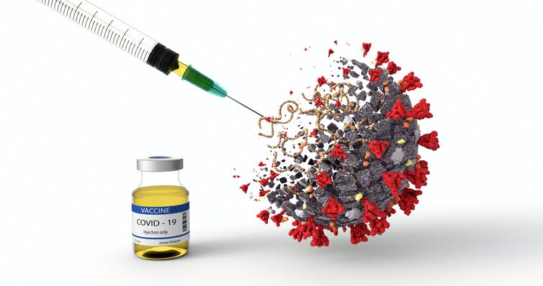
COVID-19 Vaccine Update
Jane Kelly, MD
Assistant State Epidemiologist
SC DHEC
December 10 2020

Slide 2
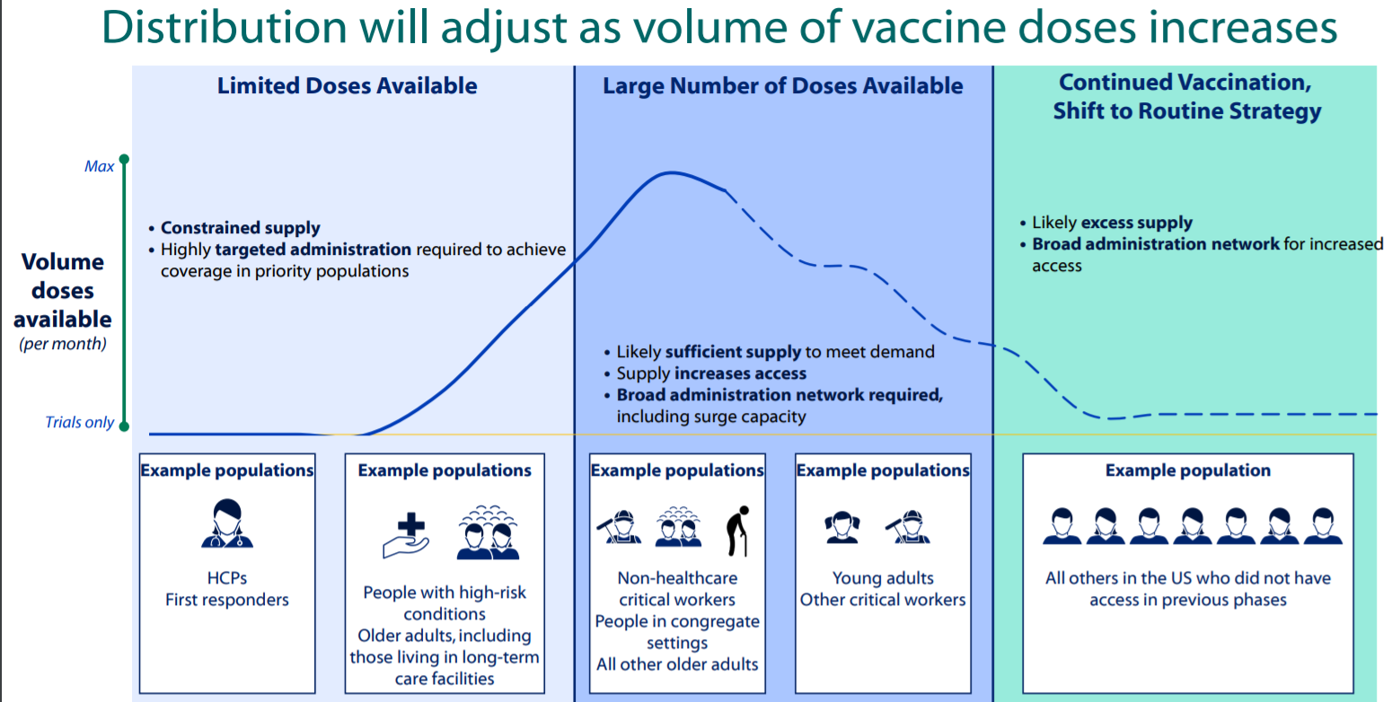
Phased vaccine allocation

Slide 3
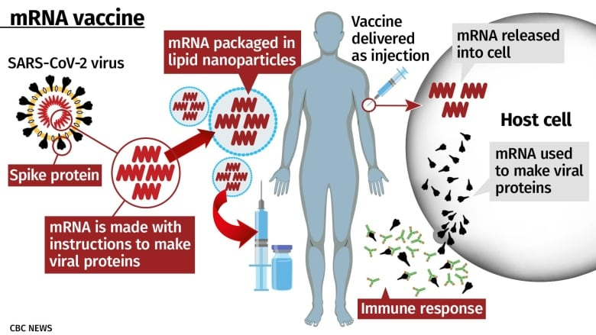
New vaccine technology

Slide 4
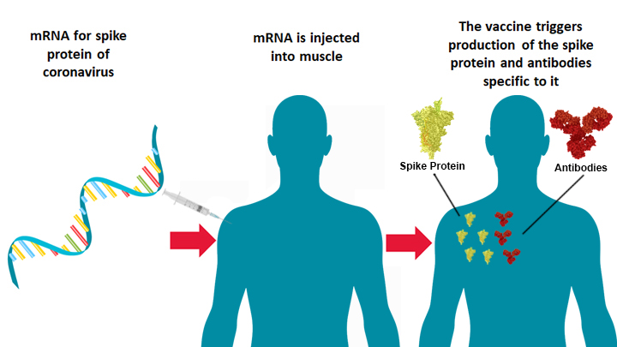
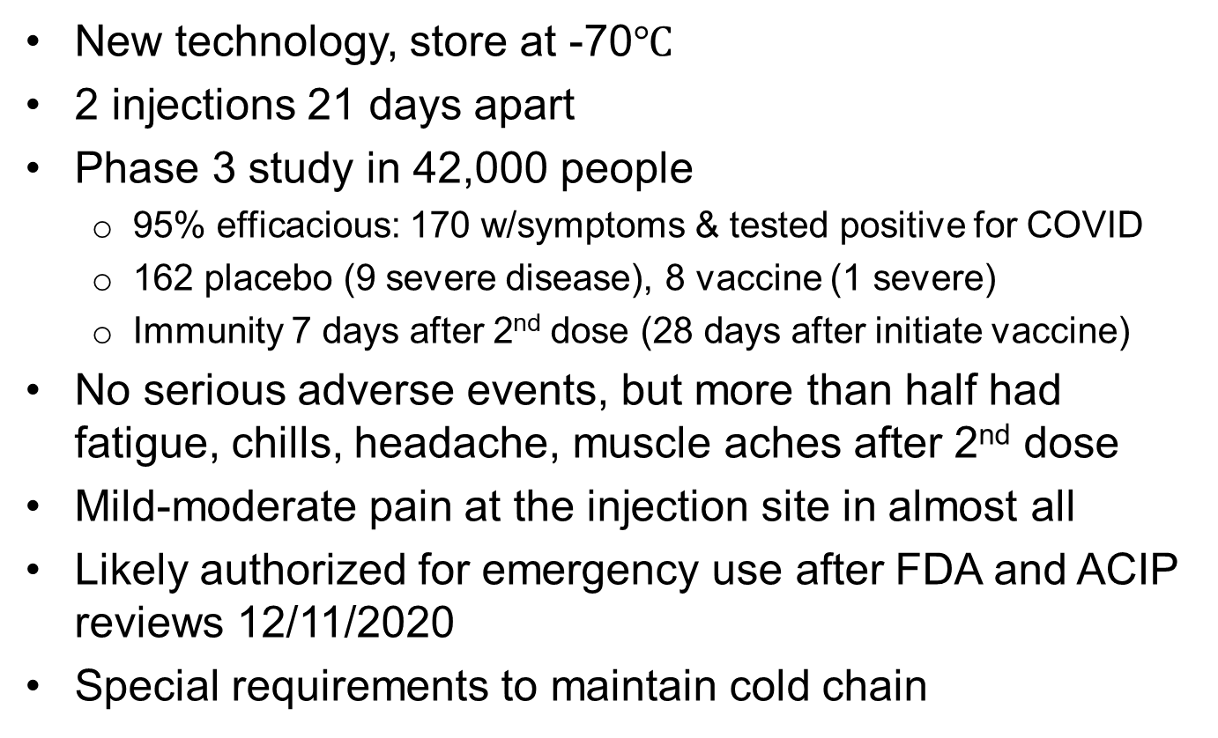
Pfizer
New technology, store at -70$℃$
2 injections 21 days apart
Phase 3 study in 42,000 people
  95% efficacious: 170 w/symptoms & tested positive for COVID
  162 placebo (9 severe disease), 8 vaccine (1 severe)
  Immunity 7 days after 2nd dose (28 days after initiate vaccine)
No serious adverse events, but more than half had fatigue, chills, headache, muscle aches after 2nd dose
Mild-moderate pain at the injection site in almost all
Likely authorized for emergency use after FDA and ACIP reviews 12/11/2020
Special requirements to maintain cold chain
https://www.nejm.org/doi/full/10.1056/NEJMoa2027906?query=featured_coronavirus

Slide 5
Pfizer vaccine logistics
Training on the logistics handling of Pfizer vaccine cannot be sent out until EUA is approved.
When EUA approved, DHEC will send handling information as soon as we are cleared to send it, as early as this week
Videos on how to handle the vaccines.
Information on the Pfizer webpage

Slide 6
Pfizer vaccine logisitics
Vaccine sent via a thermal shipper
Three options for storage:
  Ultra-low-temperature freezers
  Pfizer thermal shippers can be used as temporary storage units by refilling with dry ice every five days for up to 30 days of storage.
  Refrigeration units that are commonly available in hospitals
  Once thawed, vaccine can be stored for five days at refrigerated 2-8°C conditions

Slide 7
Emergency Use Authorization (EUA)
EUA issued only after safety and efficacy standards are met
Determination that the known and potential benefits of the investigational product outweigh its known and potential risks
Use of an investigational vaccine under an EUA is not subject to informed consent requirements; rather a Fact Sheet is provided

Slide 8
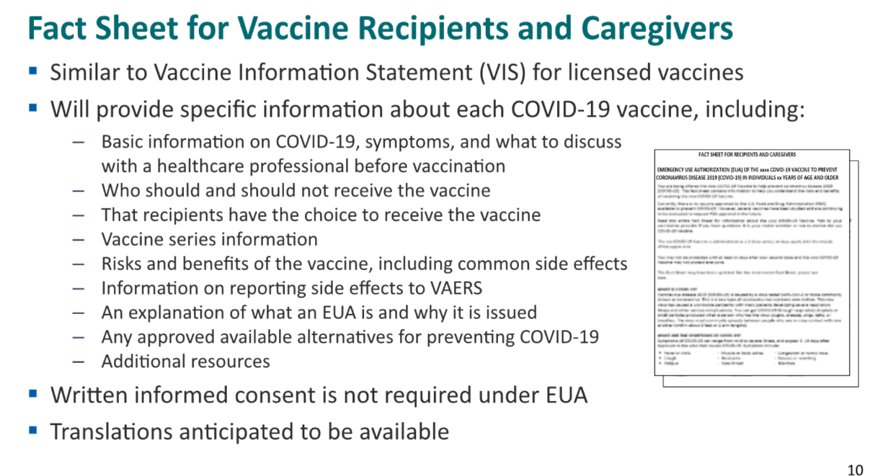
EUA Fact Sheet

Slide 9
Vaccine Allocation
CDC has indicated SC’s anticipated allocation will be ~200,000 to 300,000 doses by the end 2020
Those amounts are subject to change
We won't know exact amount until doses received
Current plan is weekly shipments as manufacturing increases
DHEC and the Vaccine Advisory Committee have draft plans for vaccine allocation for 1a and later phases
Awaiting opportunity to review the ACIP recommendations on Dec. 11, 2020 before finalizing plans for Phase 1b, 2 and 3

Slide 10
Phase 1a Vaccination
ACIP recommendations: “Health care personnel defined as paid and unpaid persons serving in health care settings who have the potential for direct or indirect exposure to patients or infectious materials”
Initial supply of vaccine will be limited; sub-prioritization is necessary
DHEC recommends vaccinating frontline workers in a healthcare setting that are at highest risk of contracting COVID-19 and who are essential to preventing mortality among confirmed COVID-19 cases
Protecting the individual workers but also protecting the health care system

Slide 11
Phase 1a Vaccination
Persons performing direct medical care to suspected and/or confirmed COVID-19 patients
Ancillary staff directly interacting with suspected and/or confirmed COVID-19 patients
Emergency room staff at high risk of exposure to suspected and/or confirmed COVID-19 patients
Paid and volunteer medical first responders (EMS, paramedics, fire department personnel who provide emergency medical services) and hospital transport personnel in direct contact with suspected and/or confirmed COVID-19 patients

Slide 12
Phase 1a Vaccination
Persons providing direct medical care in
Correctional facilities
Dialysis and infusion centers
Outpatient medical settings treating persons with suspected or confirmed COVID-19 infection
Settings where monoclonal antibodies for COVID-19 infusions were given
Home health and Hospice workers

Slide 13
Phase 1a Vaccination
Residents and staff in long-term care facilities vaccinated through federal/pharmacy partnership
DHEC will provide guidance on sub-prioritization of HCP when vaccine supply is limited initially
Guidance on scheduling to avoid potential clustering of worker absenteeism related to systemic reactions associated especially with the 2nd dose of vaccine
DHEC will not require vaccination though individual facilities may as a condition for employment (similar to influenza vaccine)

Slide 14
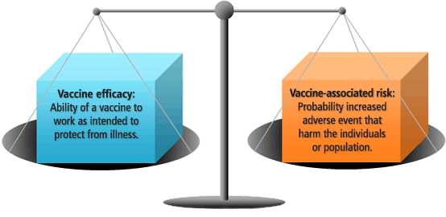
Safety and
Reactogenicity
Decision to vaccinate weighs benefit and risk
Generally, want to minimize reactogenicity
  Public perception of “flu” from influenza vaccine (i.e., innate immune response)
Sometimes a reactogenic vaccine is better
  New shingles vaccine (97% vs 51%)
Patient’s perceived benefit vs. risk impacts willingness to receive vaccine

Slide 15
What symptoms may occur?
Moderna and Pfizer vaccines
(Results from limited number of people from Phase 1/2 studies)
No serious adverse events
Fewer and milder symptoms with the 1st dose than 2nd
More than half had mild-moderate fatigue, chills, headache, muscle aches after 2nd dose
Mild-moderate pain at the injection site
  1st dose ~60-80% mild 10% moderate
  2nd dose ~60-75% mild, up to 25% moderate)
Up to 3% severe headache, up to 2% severe fatigue after 2nd dose
https://www.nejm.org/doi/full/10.1056/NEJMoa2022483?query=recirc_mostViewed_railB_article

Slide 16

Discussing the facts around vaccine including side effects
You, as a health care professional, are a trusted voice
People need to know ahead of time about possible local and systemic symptoms (so they are not surprised!)
Avoid the term “side effects”
Use “temporary symptoms”
Explain the symptoms are a sign that the vaccine is working; the immune system is responding
Notes:
HCP, healthcare provider; RZV, recombinant zoster vaccine.

Slide 17
What should I tell people?
Severe symptoms are rare, but mild-moderate ones are common, with the COVID-19 vaccines
Consider the shingles vaccine analogy
  Which would you prefer: the old shingles vaccine that causes fewer symptoms but only works half the time, or the new one that is 97% efficacious but may give you fever, myalgias, and fatigue for a couple of days?
  Risks of vaccine vs. risk of COVID-19 disease
  Don’t forget you can take acetaminophen
Workers might consider getting vaccinated when they have 1-2 days off following vaccination, especially after the second dose

Slide 18
What about long-term or rare side effects?
Might not know about rare or long-term side effects until millions are vaccinated
FDA and CDC will collect safety data from those vaccinated
Will also have safety data from other countries (e.g., England)
Each of us must weigh risk/benefit ratio:
  Benefit of vaccine (with 95% efficacy) protecting from COVID-19 now vs.
  Symptoms with vaccination and unknown rare or long-term risks

Slide 19
Contraindications to COVID-19 vaccine?
In the US, severe allergic reaction in ~ one of every 1.4 million doses of vaccine
2 severe allergic reactions thus far in the UK
Persons with significant allergic reaction to a vaccine, medicine or food (e.g., history of anaphylactoid reaction or those who have been advised to carry an adrenaline autoinjector) should be cautioned
  Awaiting FDA/ACIP recommendations
  May suggest wait for a different vaccine platform
  Have epinephrine and resuscitation capability available

Slide 20
Safety in Pregnancy
Pregnant women are excluded from vaccine trials
mRNA vaccine do not contain a live virus but rather induce humoral and cellular immune response through the use of viral mRNA
The theoretical risk of fetal harm from mRNA vaccines is very low
As data emerge, counseling will likely shift, as some vaccines (e.g., AstraZeneca adenovirus vector) may be more suitable for pregnant women
The Society for Fetal and Maternal Medicine recommends that healthcare workers, who are considered prioritized for vaccination, be offered the vaccine if pregnant
https://www.smfm.org/covidclinical

Slide 21
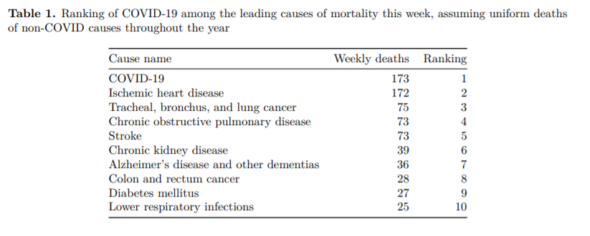
Institute for Health Metrics and Evaluation, SC, 12.06.2020

Slide 22
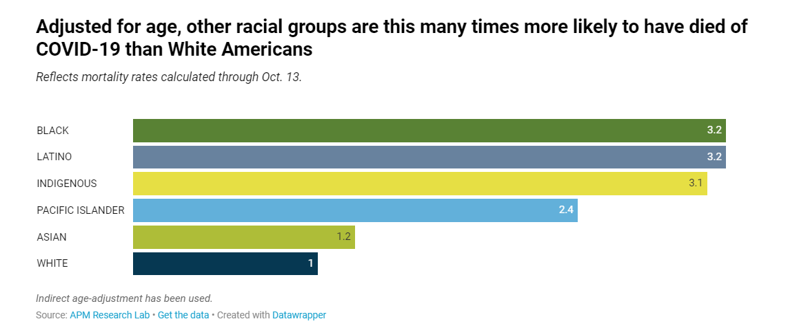
Death rates for COVID-19

Slide 23
Vaccines don’t save lives; vaccinations do!
frontline workers in medical settings at highest risk for COVID-19
Timeline not definite
USG contracted for 100M doses from each company
CDC has indicated SC allocation will be ~200K-300K doses by the end of 2020 (subject to change)
We won’t know exact amount until doses are received
DHEC anticipates this will be enough for medical first responders, frontline workers in medical settings at highest risk for COVID-19, residents/staff in LTCF
Need to stagger vaccinations (don’t vaccinate entire team at same time!), and not everyone in the first week
As more vaccine becomes available early 2021, will expand vaccination program

Slide 24
Do I need to save and store the 2nd dose? No – example Pfizer vaccine
1st week | 2nd week | 3rd week | 4th week (21 days after 1st week) | 5th week (21 days after 2nd week)
1000 doses
 | 200 doses
 |  | 200 doses
 |  |  | 200 doses + 1000 booster for Week 1
 |  |  |  | 200 doses + 200 booster for Week 2

Slide 25
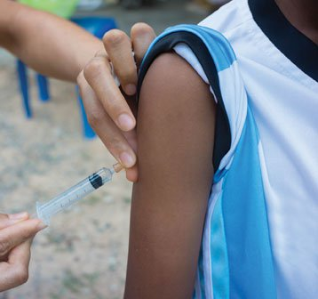
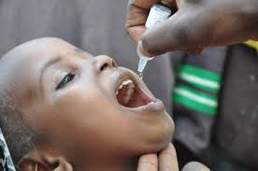
Preventing disease vs.
Preventing infection
IPV
OPV

Slide 26
COVID-19 Vaccine Questions
Are the mRNA vaccines like IPV or OPV?
Reduce infection and transmission or reduce symptomatic disease only?
In HIV terms, U = U (undetectable = untransmittable)
Does vaccinating me protect you?
Do I have to wear a mask after vaccination?
  Yes! Until we find out if V = U or we have a vast majority vaccinated
Safe in immunocompromised? Organ transplant patients?

Slide 27
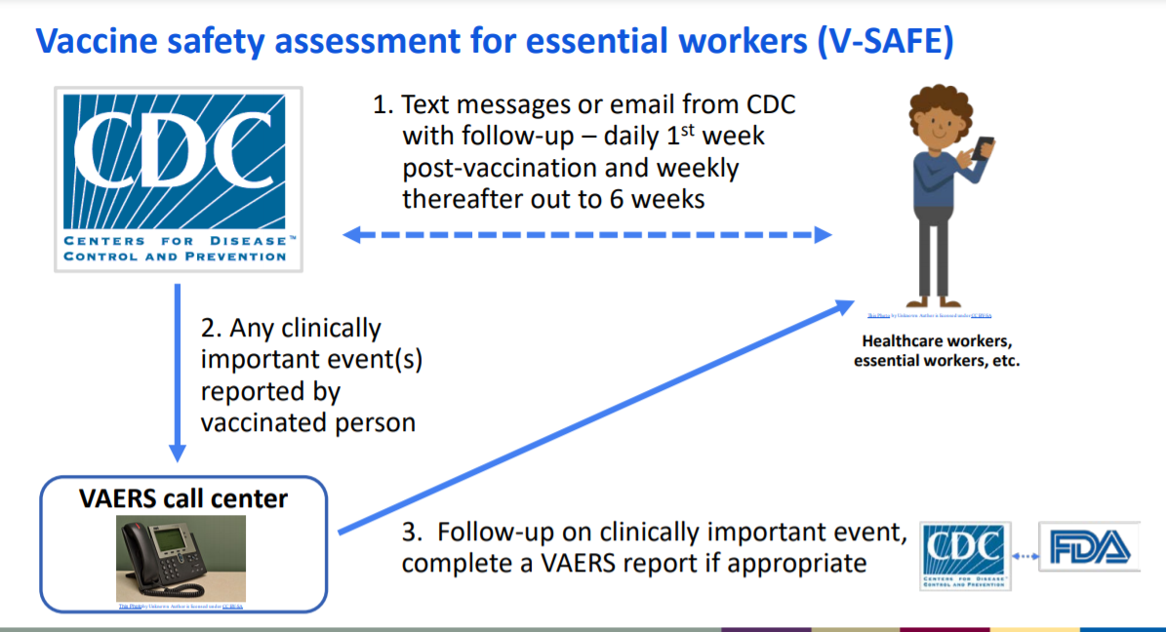
Active safety follow-up
(in addition to VAERS)

Slide 28

kellyjm1@dhec.sc.gov scdhec.gov/covid19 cdc.gov/covid19
Questions?

